Slide 1
11/25/2024
What is the effect of measurement?
Critiques of the Copenhagen interpretation
Support for the Copenhagen interpretation
An alternative: pilot wave theory
Project proposal presentation
Final project team work time

Slide 2
The Effect of Measurement
Suppose that you have a wavefunction with three regions: A, B, and C
You make a measurement and the particle is in region C
Where was the particle before the measurement?
There are several options:
Realist: it was at C. QM is incomplete, hidden variable. Example is coin flip.
Copenhagen: it was nowhere in particular, a ``superposition.'' Measurement forced the particle to ``take a stand.''
Agnostic: I don't know. Actually, it is a dumb question. Don't need to understand to use it.
Both the concepts of superposition and measurement are strange. What exactly is a superposition? Why does measurement matter?

Slide 3
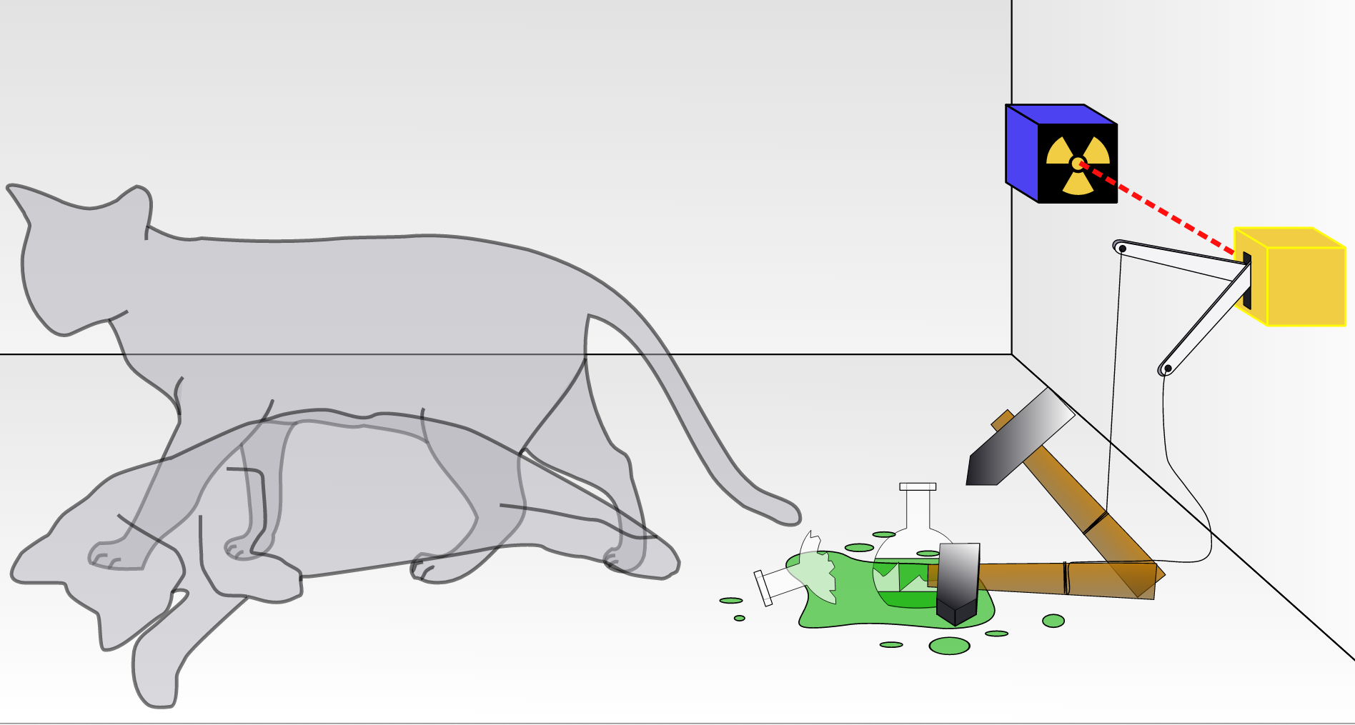
Critiques of the Copenhagen Interpretation
Schrodinger’s Cat: ``a cat imagined as being enclosed in a box with a radioactive source and a poison that will be released when the source (unpredictably) emits radiation, the cat being considered (according to quantum mechanics) to be simultaneously both dead and alive until the box is opened and the cat observed.’’
Does the counter make the measurement?
Illustrates absurdity of superposition
Einstein, Podolsky, and Rosen (EPR) paradox (1935)
Entangled particles are coupled in a way such that their particles are not independent of one another, no matter how far apart they are. Example are particles known to have total spin 0.
The paradox if entangled states are separated and one measured, it causes an instantaneous change in the other particle. This means that information is going faster than light, in contradiction with relativity.
EPR called this ``spooky action at the distance.''

Slide 4
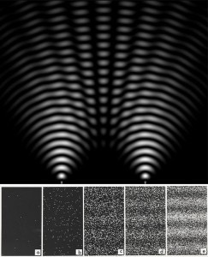
Support for the Copenhagen Interpretation
Ghost Double Slit - wave interference patterns observed with only one particle at a time
Feynman: ”is impossible, absolutely impossible, to explain in any classical way."
Bell's Theorem (1964)
Another way to state EPR paradox: If particles can't talk faster than light, than superposition is wrong.
Bell came up with experiment with different results when particles talk faster than light or not. When it was done, it showed that particles can indeed talk faster than light. ``Spooky action at a distance'' is true.
However this does NOT mean that QM is true, but that it is consistent with the results.

Slide 5
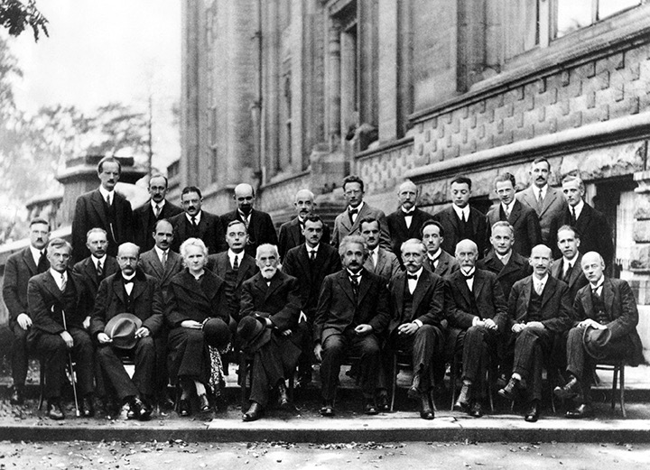
Pilot Wave Theory
Alternative to Copenhagen interpretation advocated by de Broglie. Elaborated by David Bohm (1952), so also called Bohmian mechanics.
Particles ride on a ``pilot wave''
``Hidden variable'' theory
Deterministic
Explains quantum effects
Bouncing droplet experiments show that quantum effects can be seen in visible objects
Pilot wave theory presented by de Broglie at 1927 Solvay Conference in Brussels

Slide 6
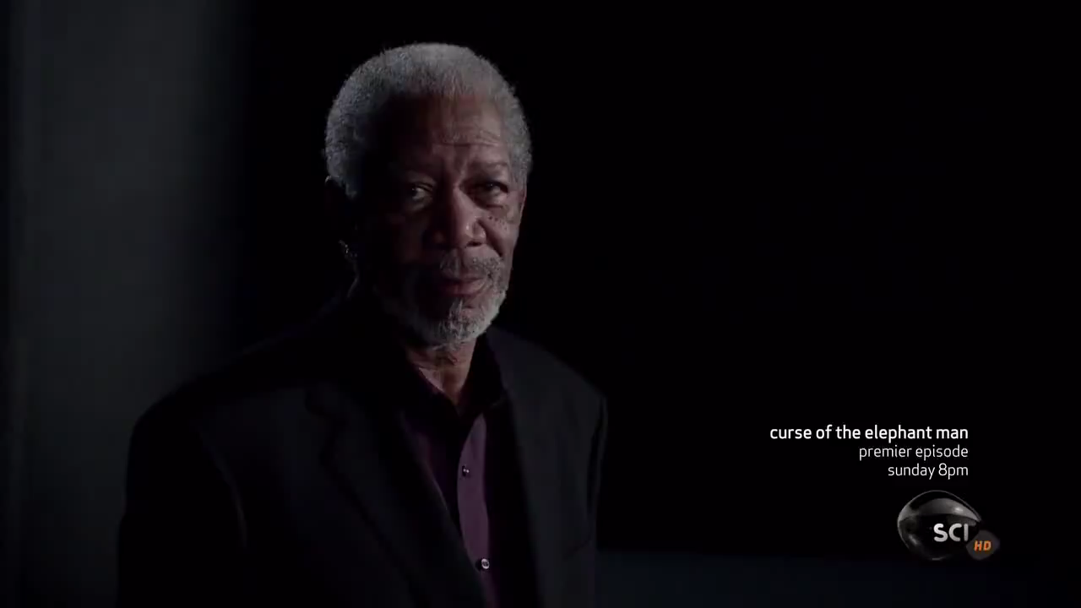

Slide 7
Review Questions
What are three interpretations of the meaning of measurement?
How did Schrodinger and Einstein criticize the Copenhagen interpretation?
What key experiments are thought to support non-intuitive aspects of the Copenhagen interpretation?
What deterministic hidden variable theory can explain many quantum effects without superposition?

Slide 8
References
John Bush. The new wave of pilot-wave theory. Physics Today 68 (8), 47–53 (2015); https://doi.org/10.1063/PT.3.2882
H. Nikolic. Would Bohr be born if Bohm were born before Born? Am. J. Phys 76, 143-146 (2008)

